Slide 1
Italia R859 Provision Change Summary
March to June 2025 | Corrected Data

Slide 2
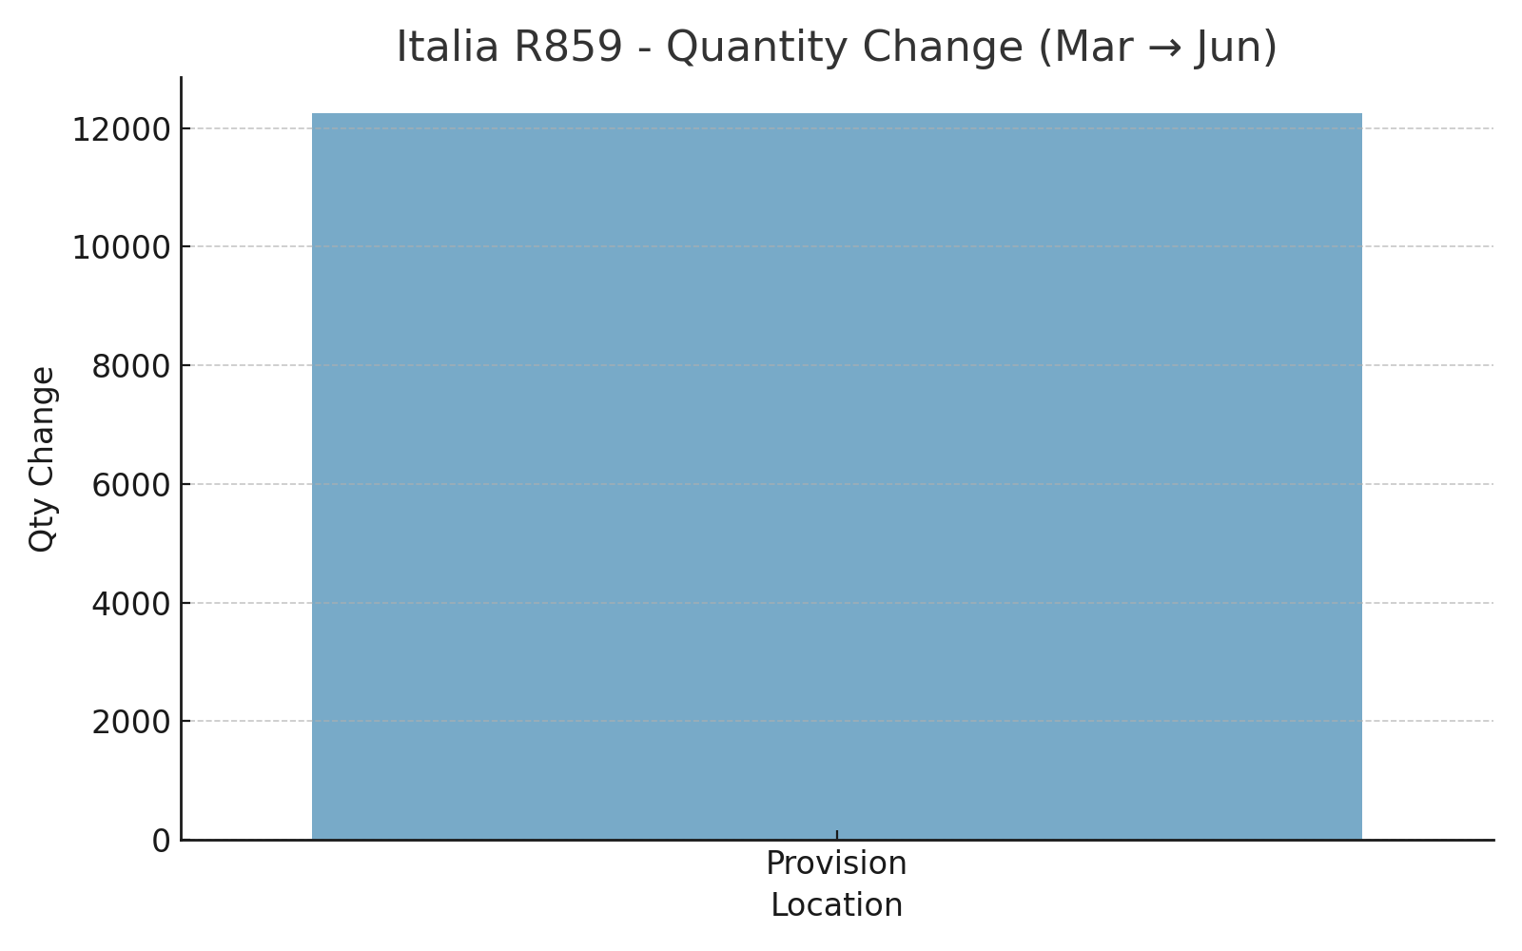
Italia R859 - Quantity Change (Mar to Jun)

Slide 3
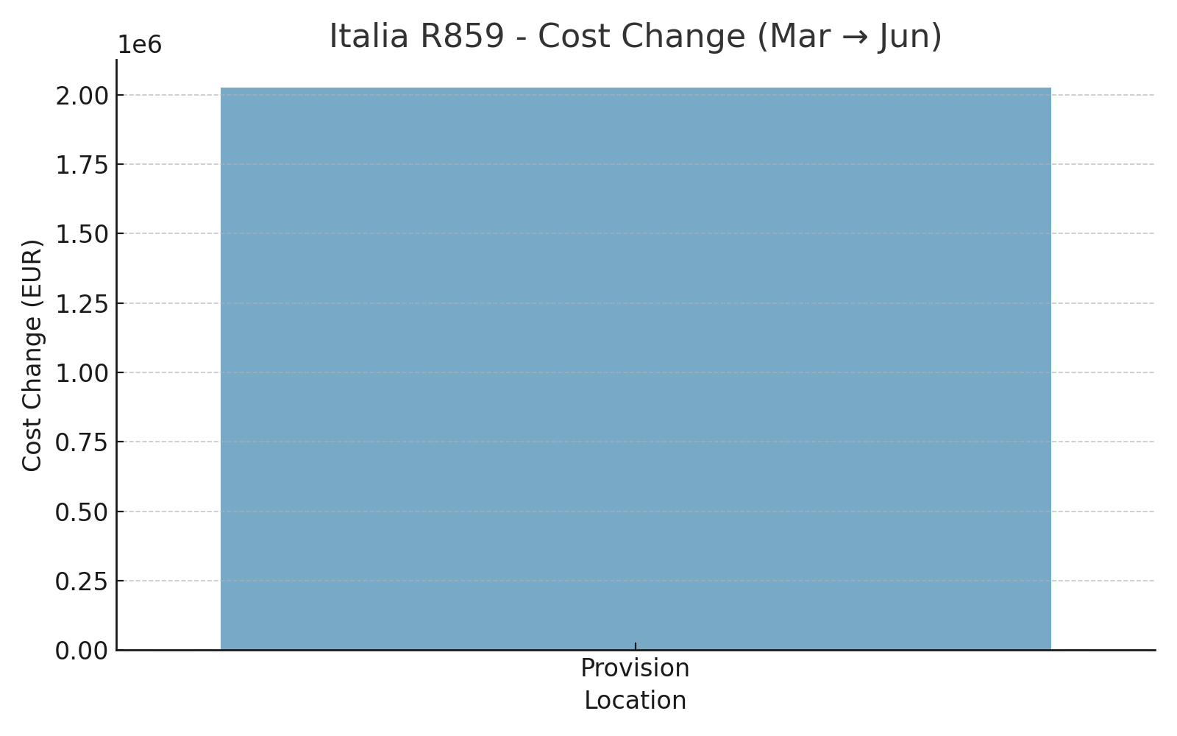
Italia R859 - Cost Change (Mar to Jun)

Slide 4
Updated Written Summary
• Provisioned inventory increased by 12,252 units from March to June.
• Total value rose by €2.03M, from €94.3M to €96.3M.
• Indicates active restocking or updated valuation in the provision category.

